Slide 1
Welcome to Lifelines!
2023

Slide 2
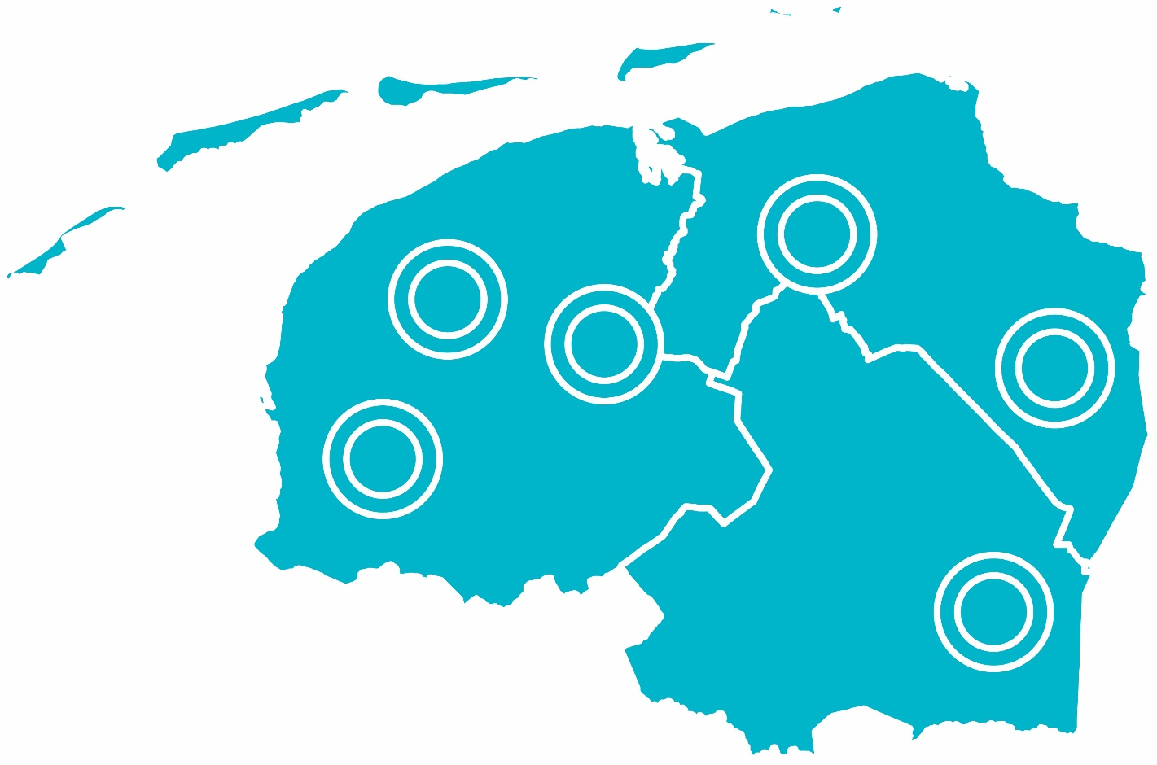
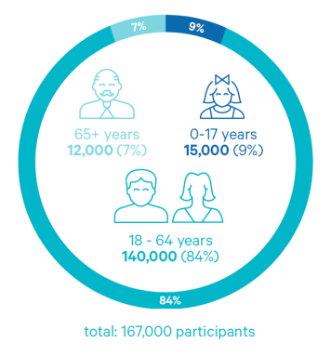
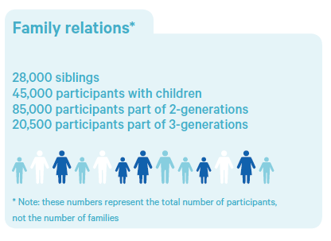
What is Lifelines?
Prospective research to study health and disease
10% Northern Netherlands
healthy & disease
3 generations
We collect, store and share for more healthy years
for worldwide groundbraking reasearch

Slide 3
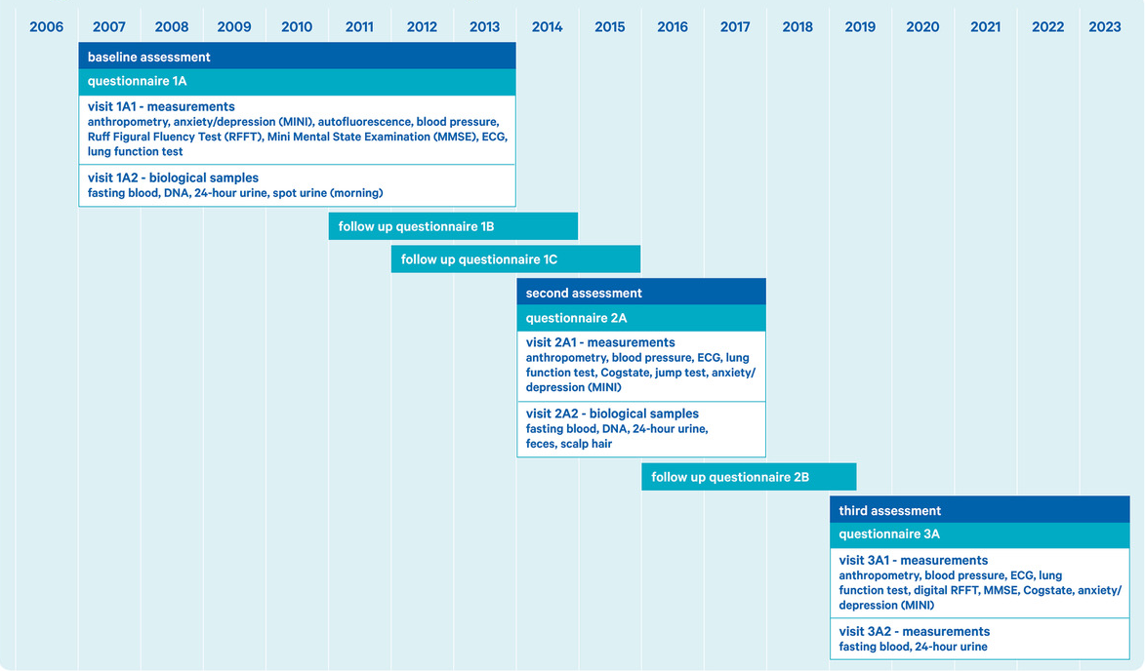
General assessments

Slide 4
Available data - topics
Notes:
For complete metadata overview check Lifelines wiki

Slide 5
Available bio-samples
Biobank overview

Slide 6
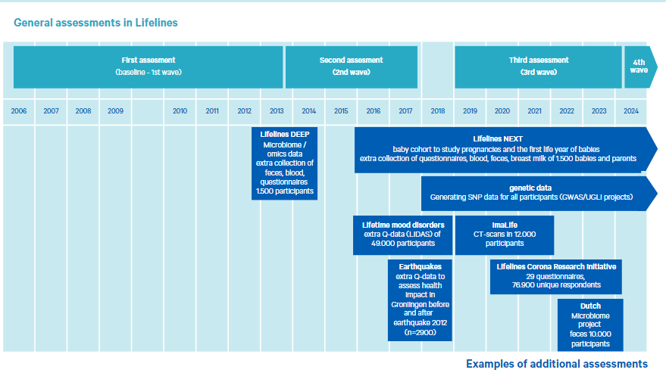
Research opportunities - open protocol

Slide 7
Research opportunities:
Healthy and diseased
Combine with other datasources
onset + early diagnose + prevention
But what if you need more….
Statistics Netherlands
Medical registries
PALGA
IKNL
Environmental data (GECCO)
Air quality
Noise
Walkabilty index
Neighborhood scores

Slide 8
Research opportunities – value of Lifelines
Benefits for your research:
Exponential growth value of Lifelines
get easy access to real world data
(re)use (FAIR) data – get grants
save time (costs) – start analysing
create impactful high quality research - 95% or our users recommend data, samples and services
join the community – expand your research

Slide 9
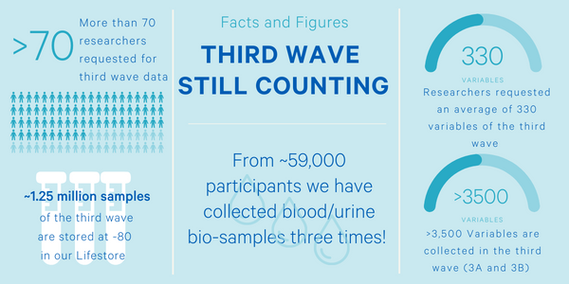
3th wave data now available

Slide 10
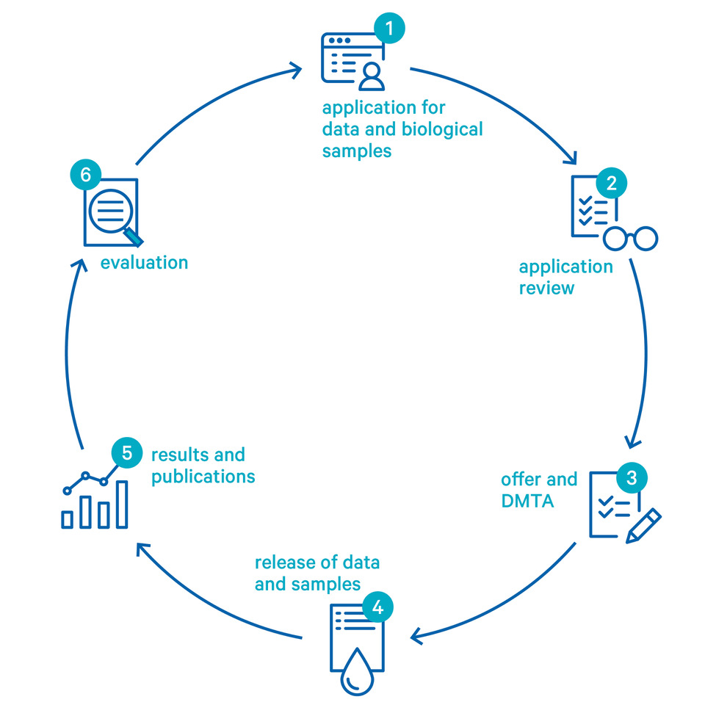
How can we help?
Feel free to contact us for questions or inspiration, also for grants
Data services – FAIR and easy access
Data access in Workspace om UMCG HPC
Student workspaces* / free dataset for education
Start fee per project (data) € 3000 to € 4500
*Student fee € 600 for 6 months
https://www.lifelines.nl/researcher/how-to-apply/costs-biobank-lifelines

Slide 11
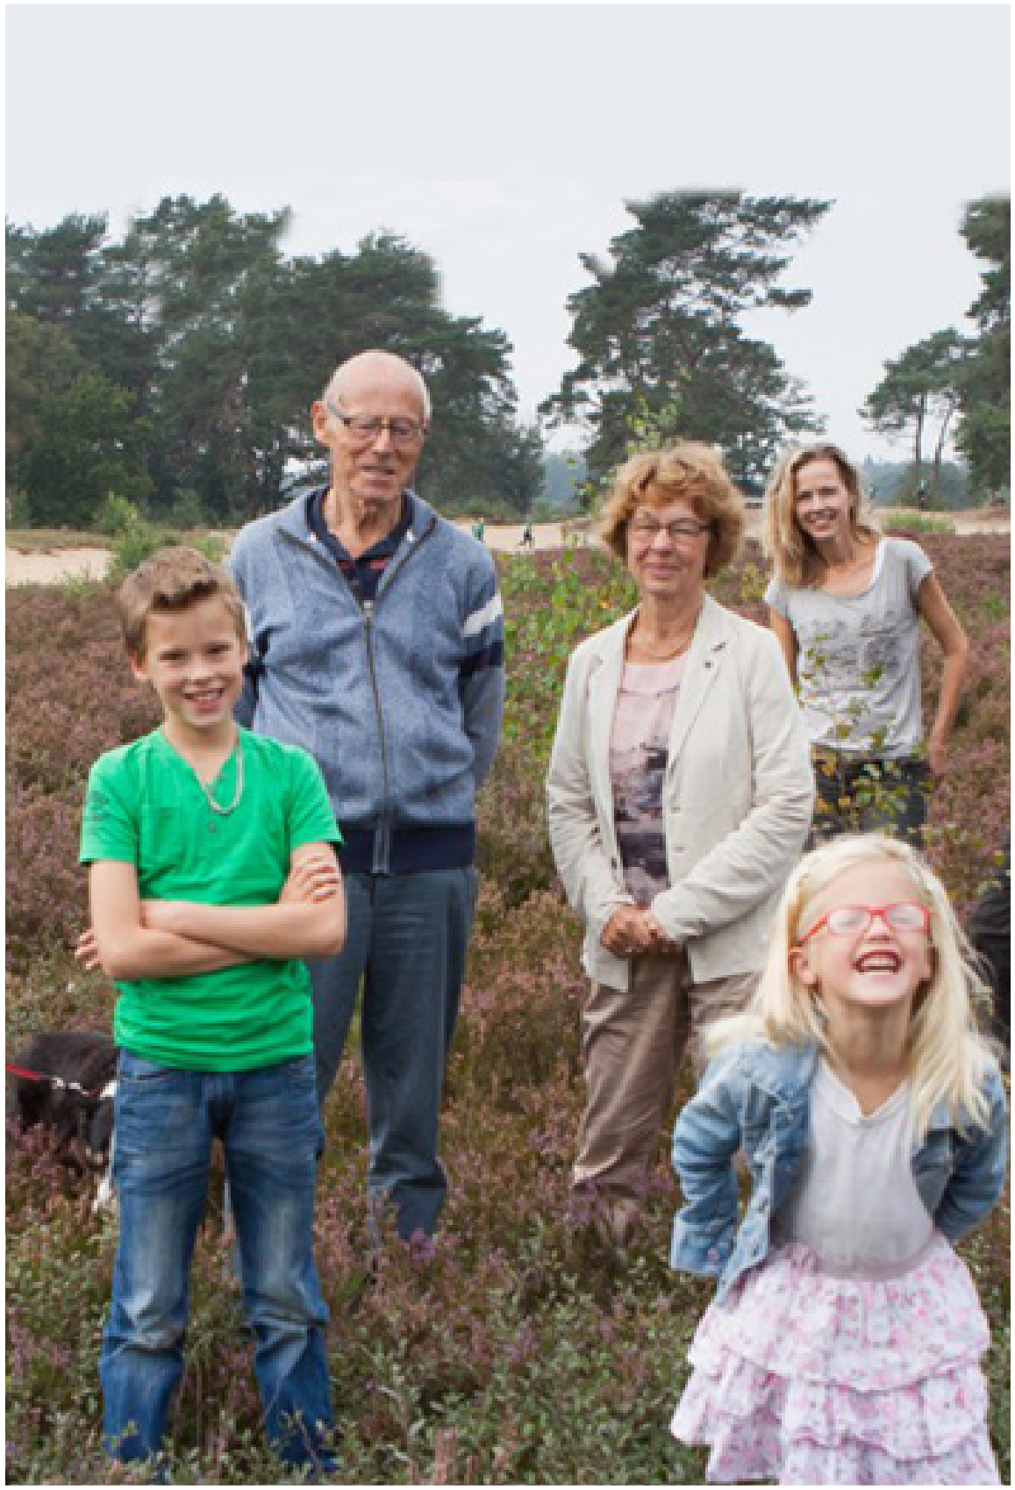
Thank you for your attention
For more information:
Data catalogue: https://data-catalogue.lifelines.nl/
Lifelines wiki: https://wiki.lifelines.nl/
Interactive map: https://inzicht.lifelines.nl/
Youtube: collect and share for more healthy years
Stay in touch:
research@lifelines.nl (general info, grants, applications)
data@lifelines.nl (data service questions)
Notes:
Lifelines – collect and share for more healthy years – YouTube
https://www.youtube.com/watch?v=IDN5PHEaB8Y

